Slide 1
Structures and Pointers
Better data structures

Slide 2
What is a structure
A structure is a user defined data type. Using a structure we have the ability to define a new type of data considerably more complex than the types we have been suing.
A structure is a collection of variables referenced under one name, providing a convenient means of keeping related information together.
The variables which make up a structure are called structure elements.
We use ‘struct’ keyword to define structures.

Slide 3
Defining a structure
struct bioData { char name[50]; char gender; int age; char address[50]; };
int main() { int a, b, c; struct bioData w1, w2, w3; …….. ……… }

Slide 4
Defining a structure
struct bioData { char name[50]; char gender; int age; char address[50]; } w1, w2, w3 ;

Slide 5
Demonstration of Structures as part of class activity

Slide 6
Demonstration of Array of Structures as part of class activity

Slide 7
Demonstration of Pointer to Structures as part of class activity

Slide 8
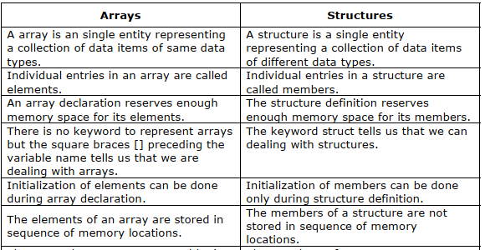

Slide 9
Pointers
A pointer is a variable which contains the address of another variable in the memory.
The unary operator & gives the “address of a variable”. The dereference operator * gives the “contents of an object pointed by a pointer”.
Advantages of pointer:
Produces compact and efficient code.
Provides easy way to represent complex and multidimensional arrays.
Increases the execution speed of a program.
Helps reduce the complexity of a program.
C uses pointers explicitly with arrays, structures and functions.

Slide 10
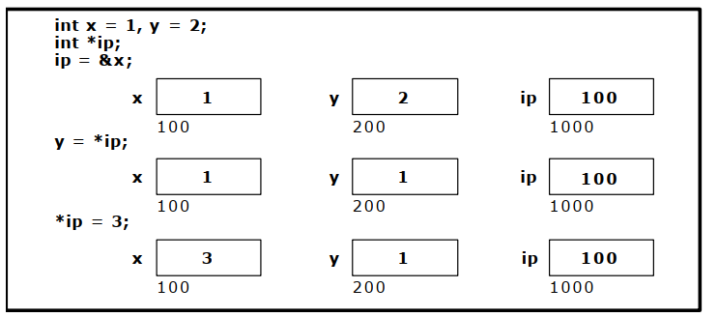
Pointers
int main() { int x=1; int y=2; int *ip; ip=&x; y=*ip; *ip=3; }

Slide 11
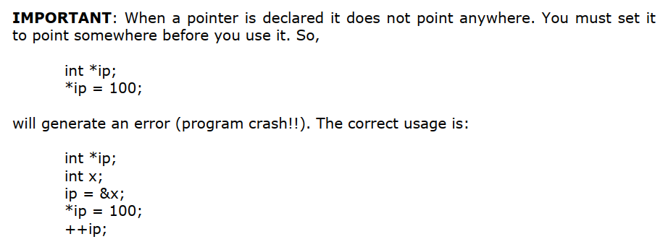
Pointers

Slide 12
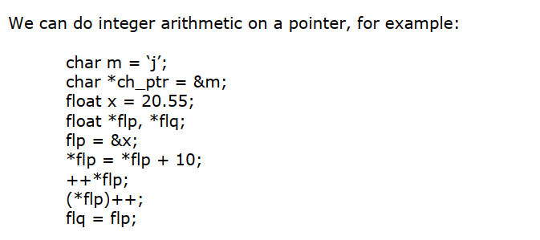
Pointers Arithmetic

Slide 13
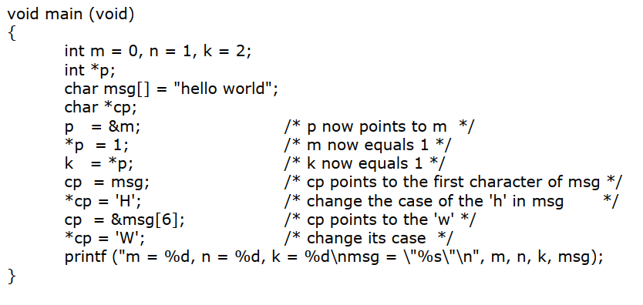
Pointers

Slide 14
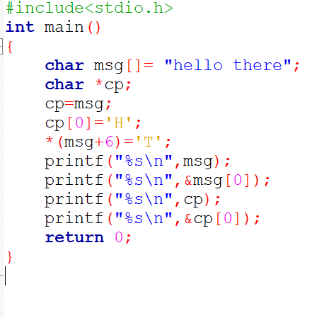
What will be the output?

Slide 15
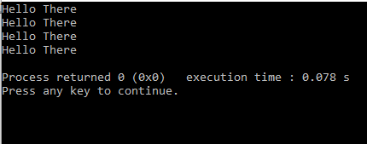
What will be the output?

Slide 16
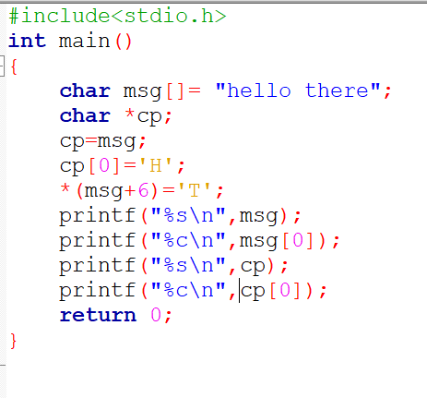
What will be the output?

Slide 17
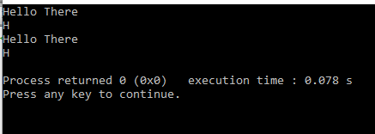
What will be the output?

Slide 18
Demonstration : how to access elements of a 1D array using pointer.

Slide 19
Demonstration : how to access addresses of elements of a 1D array using pointer.

Slide 20
Demonstration : how to use pointers to array of characters.

Slide 21
Demonstration : Array of pointers to store two dimensional arrays of characters.

